Slide 1

Performance Optimization for Native iOS Apps
Daniel Norton 4:00 – 5:15

Slide 2

github: danielnorton werk: leankit.com twitter: @daniel_norton
github.com/danielnorton/GitHubReader
GitHub
The Demo App

Slide 3
Goals for Today
Detective work
Iterate to improve a poorly performing app
Experiment to gain insight
Use the demo code as a sandbox for additional learning
Fork the repo (I’ll show it again later)
follow the tag suggestions in this slide deck
Run your own experiments later

Slide 4
Tools at Our Disposal
Xcode
Instruments
Multithreading & Networking
Core Data
Caching
Perceived Performance

Slide 5
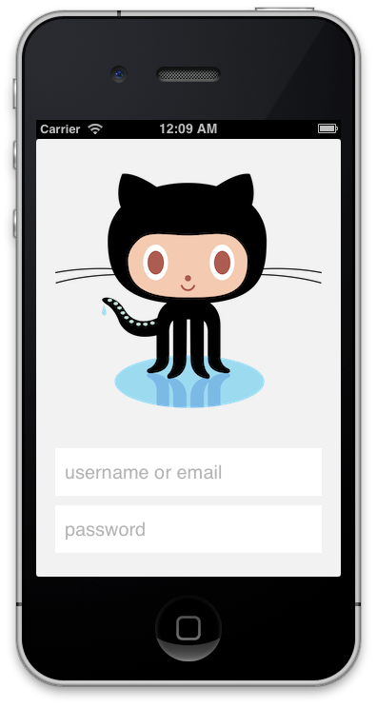
git checkout 01_perf_baseline
Quick tour through the app

Slide 6
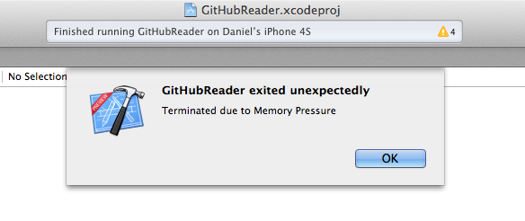
... a little while later
Well, try it again

Slide 7
What do we intuitively see?
Crash due to memory pressure.
Slow app launch after being logged in.
Choppy & blocking animation from parent to child views, particularly when opening a large list of commits.
Choppy scrolling, particularly when a cell has images.

Slide 8
What tends to be a sign of trouble?
Memory Pressure
crashes
CPU Pressure
slow UI rendering
choppiness
tight loops can cause memory pressure and/or crashes
Network Overutilization
Lengthy or frequent waiting for next interaction
Ignoring Perceived Performance
User panic can exacerbate the problem

Slide 9
Let’s start analyzing with Instruments
Device Simulator
Leaks ✓ ✓ memory leaks, blocking calls
Time Profiler ✓ ✓ blocking calls
Activity Monitor ✓ ✓ cpu, memory, network
Core Data ✓ faults, reads, and writes
Core Animations ✓ refresh rate
Notes:
Leak: git checkout 08716ad44b27def4ece051072015f3c9b4038cda
[ BRLoginService.m ]
Fix: git checkout f2ad04694a5d39202428e8efd39d9a721dfb3ff8

Slide 10
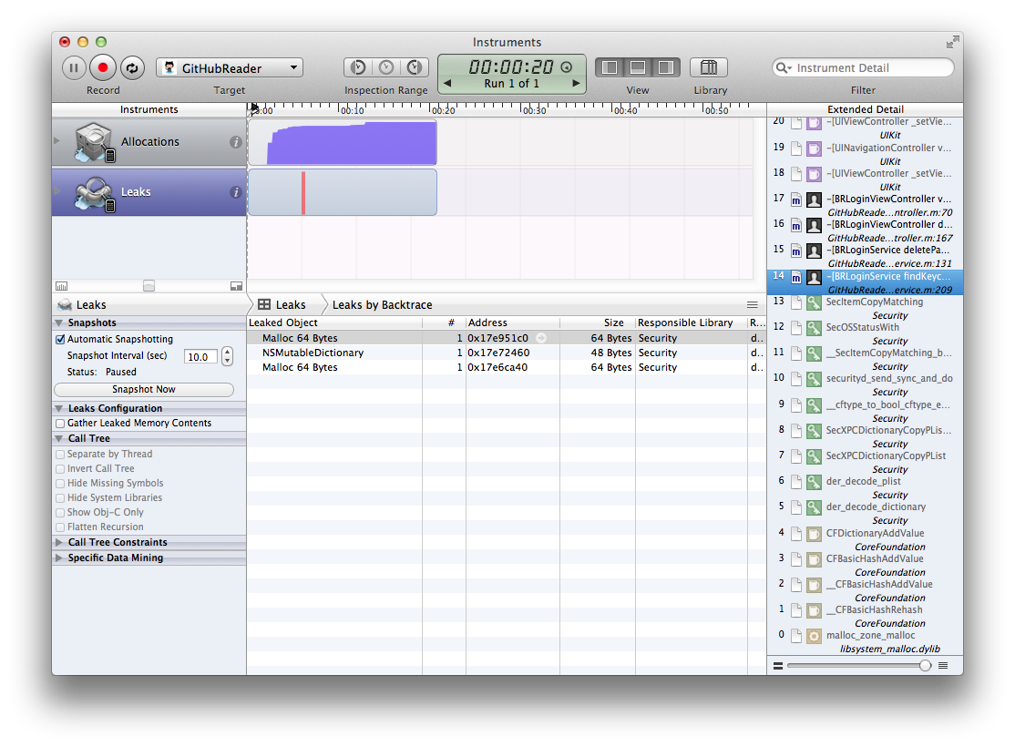
git checkout 01_perf_baseline
Leaks Instruments
Find the Leak

Slide 11
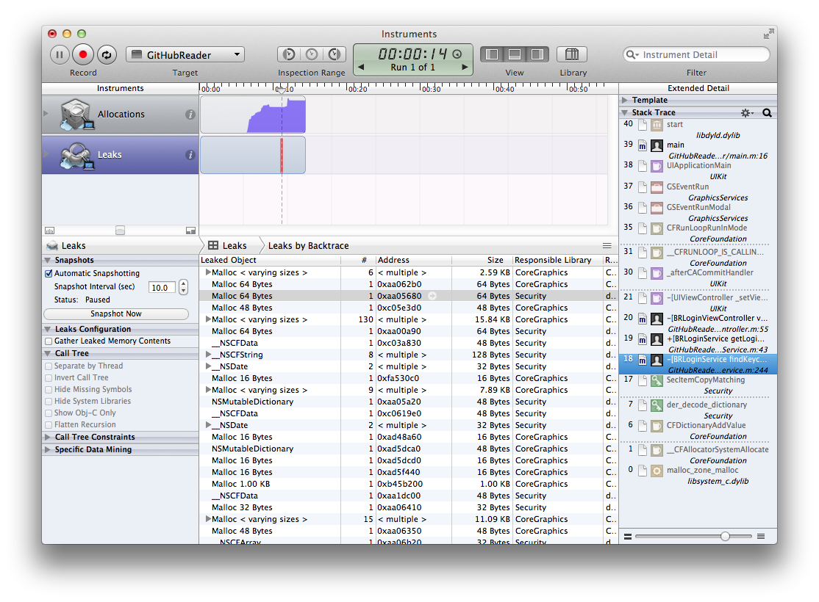
Objects
in memory
(smaller is
better)
Stack
trace w/
a leak
Leak
detected
(preferably none)
Leaked
bytes

Slide 12
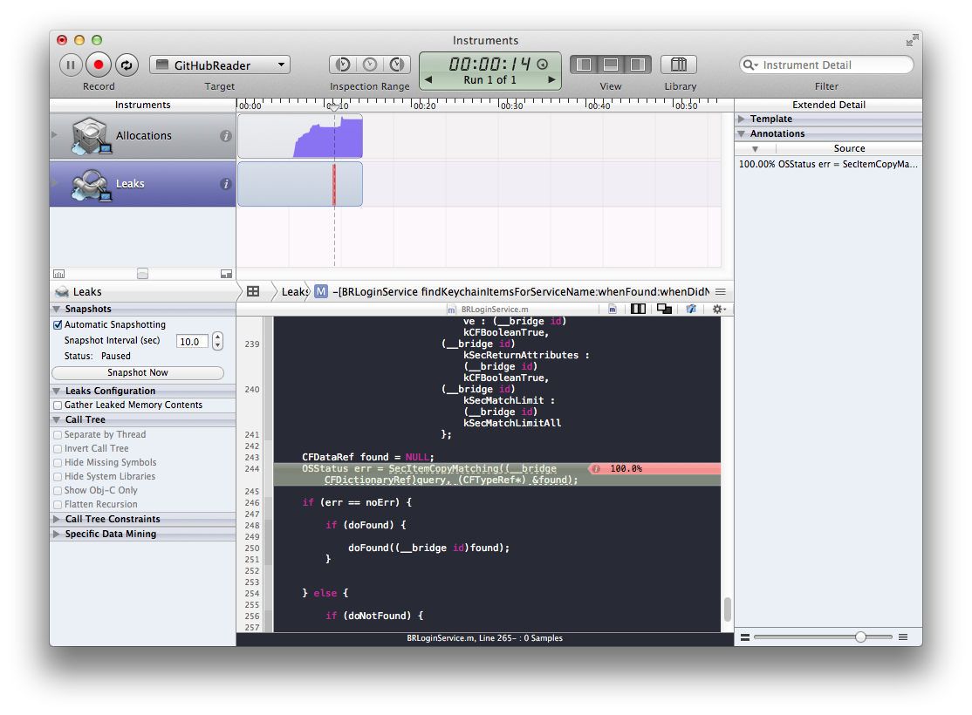
Stack trace
breadcrumbs
Where in code
leaked memory
was allocated

Slide 13
git checkout 02_memory_leak
Fix the memory leak

Slide 14
BRLoginService.m : 216
CFDataRef found = NULL;
OSStatus err = SecItemCopyMatching((__bridge CFDictionaryRef)query, (CFTypeRef*) &found);
if (err == noErr) {
if (doFound) {
doFound((__bridge id)found);
}
CFRelease(found);
} else {
if (doNotFound) {
doNotFound(query);
}
}
02_memory_leak

Slide 15
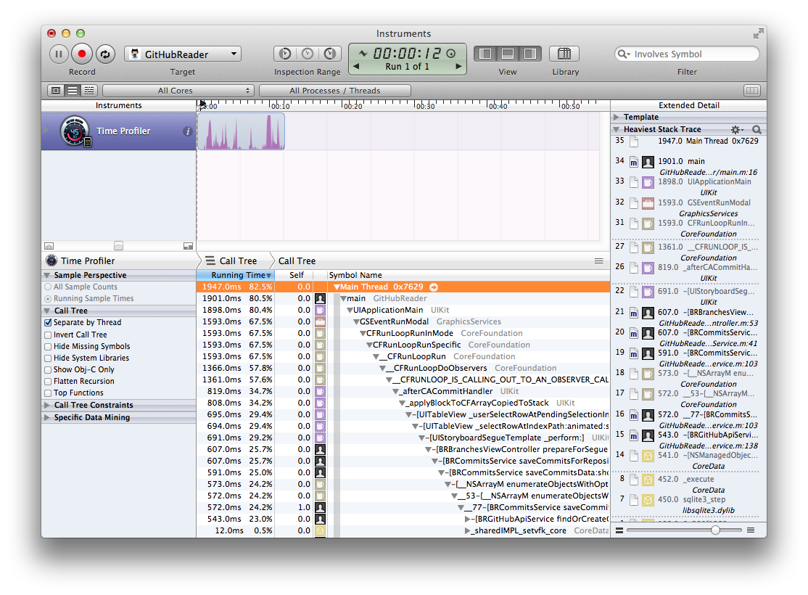
git checkout 02_memory_leak
Time Profiler Instruments
Find the blocking messages
Leaks Profiler Instruments
Find the big data loop

Slide 16
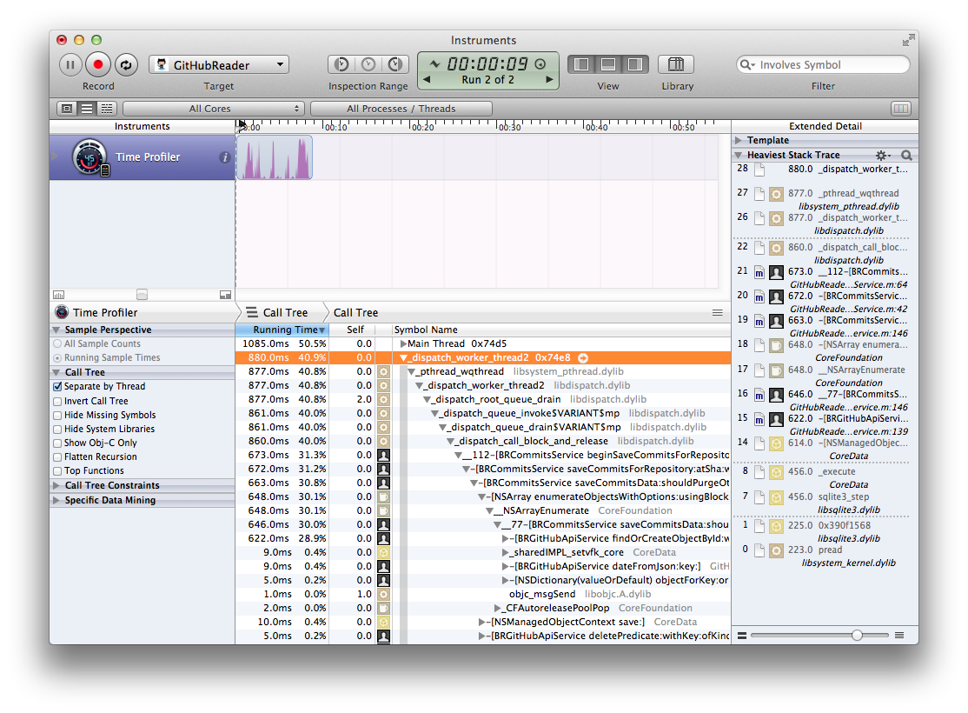
Relative time
of messages
Heaviest stack
trace on selected
thread
Threads

Slide 17

Network access and data manipulation blocking the main UI thread

Slide 18
Do as little as possible on the Main UI Thread
Not a simple task
Several things that should be done off the main thread
Retrieve data from API
Parse it (deserialize json, spin through arrays, etc.)
Store it in Core Data
Communicate completion or failure back to the main UI thread

Slide 19
Main UI Thread
User Taps a Table Cell
Call API
Parse json
Save to Core Data
Present Next UI
Network and Data operations on the Main UI Thread

Slide 20
Background Thread
Call API
Parse json
Save to Core Data
Main UI Thread
User Taps a Table Cell
Present Next UI
Network and Data operations on the Main UI Thread

Slide 21
Asyncronous Network & Data Options
Basic implementation of id<NSURLConnectionDataDelegate>
Pros
Network activity happens asyncronously
Can cancel a connection
Relatively simple, boilerplate code
Can choose how to store incoming data chunks (in memory, page to disk, etc.)
Cons
In simplest implementation, delegate callbacks come back to main UI thread

Slide 22
Asyncronous Network & Data Options
NSOperation and NSOperationQueue
Pros
Can enqueue multiple operations and throttle concurrency
Can create rich dependancies between operations
Cons
Must handle for Core Data concurrency rules

Slide 23
Asyncronous Network & Data Options
Grand Central Dispatch
Pros
Very easy to port syncronous calls to background thread
Cons
Must handle for Core Data concurrency rules

Slide 24
Core Data concurrency rules
NSPersistantStoreCoordinator is thread safe
NSManagedObjectContext is not thread safe
NSManagedObjectID is thread safe
NSManagedObject is not thread safe

Slide 25
Background Thread
NSManaged
Object
Save to Core Data
Main UI Thread
NSPersistant
Store
Coordinator
NSManaged
ObjectContext
Network and Data operations on the Main UI Thread

Slide 26
Background Thread
NSManaged
ObjectContext
NSManaged
Object
Save to Core Data
Send NSNotification
Main UI Thread
NSPersistant
Store
Coordinator
NSManaged
ObjectContext
Receive
NSNotification
Network and Data operations on the Main UI Thread

Slide 27
git checkout 03_async_gcd
Async network and Core Data using GCD
Paging large data sets
Turn off Gravatars for the moment

Slide 28
git checkout 03_async_gcd
Async network and Core Data using GCD

Slide 29
BROrganizationService.m
- (BOOL)saveDataWithError:(NSError **)error {
// Do this work on the main UI thread
NSArray *json = [self getRemoteData];
NSManagedObjectContext *context = [[BRModelManager sharedInstance] context];
[json enumerateObjectsUsingBlock:^(id obj, NSUInteger idx, BOOL *stop) {
}];
return [context save:error];
}
02_memory_leak

Slide 30
BROrganizationService.m
- (void)beginSaveDataWithCompletion:(void (^)(BOOL saved, NSError *error))completion {
dispatch_queue_t serviceQueue = dispatch_queue_create("Service queue", NULL);
dispatch_async(serviceQueue, ^{
// do this work off the main ui thread
NSArray *json = [self getRemoteData];
NSManagedObjectContext *context = [[NSManagedObjectContext alloc] init];
[context setPersistentStoreCoordinator:
[[BRModelManager sharedInstance] persistentStoreCoordinator]];
[json enumerateObjectsUsingBlock:^(id obj, NSUInteger idx, BOOL *stop) {
}];
dispatch_async(dispatch_get_main_queue(), ^{
// do this work on the main ui thread
completion(answer, error);
});
});
}
03_async_gcd

Slide 31
BROrganizationsViewController.m
- (IBAction)didTapButton:(id)sender {
NSError *error = nil;
Service *service = [[Service alloc] init];
if (![service doSomeDataOperation error:&error]) return;
// Update the UI on the main thread
}
===============================================================================================
- (IBAction)didTapButton:(id)sender {
Service *service = [[Service alloc] init];
[service beginSomeDataOperation withCompletion:^(BOOL saved, NSError *error) {
// Update the UI on the main thread
}];
}

Slide 32
git checkout 03_async_gcd
Time Profiler Instruments to check progress
Most of “our” work is now happening off the main thread

Slide 33
git checkout 03_async_gcd
Paging large data sets

Slide 34
BRCommitsService.m
- (BOOL)saveCommitsWithError:(NSError **)error {
NSError* inError = nil;
NSMutableArray *all = [NSMutableArray arrayWithCapacity:0];
while (sha) {
NSArray *json = [self getRemoteDataWithError:&inError];
if (!json || inError) {
*error = inError;
return NO;
}
sha = [[json lastObject] valueForKeyPath:@"parents.@max.sha"];
[all addObjectsFromArray:json];
}
return [self saveCommits:all withError:error];
}
02_memory_leak

Slide 35
BRCommitsService.m
- (BOOL)saveCommitsWithError:(NSError **)error {
NSError *inError = nil;
NSArray *json = [self getRemoteDataWithError:&inError];
if (!json || inError) {
*error = inError;
return NO;
}
return [self saveCommits:json withError:error];
}
03_async_gcd

Slide 36
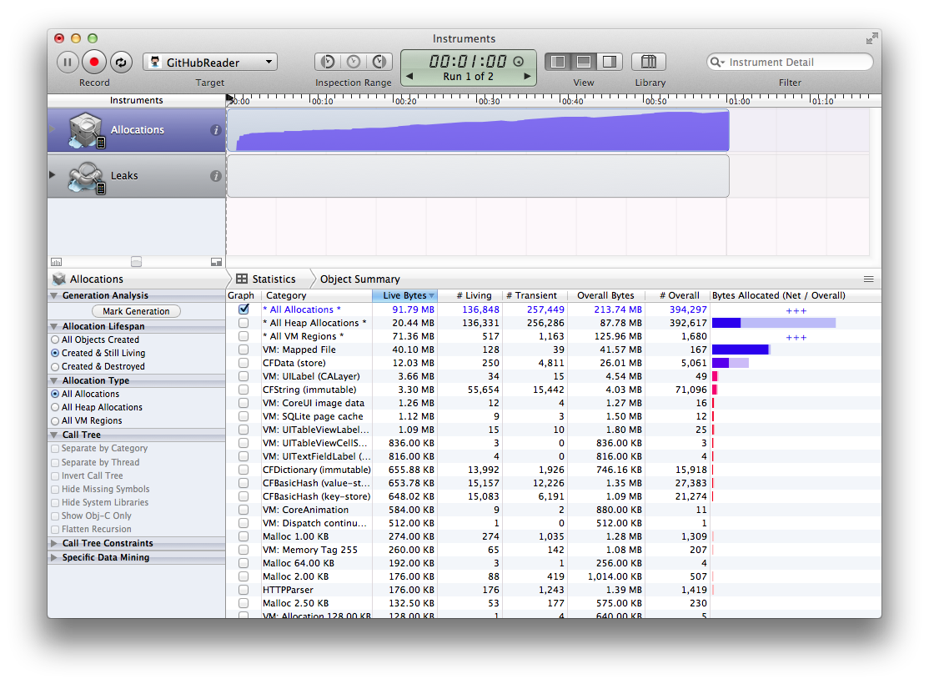
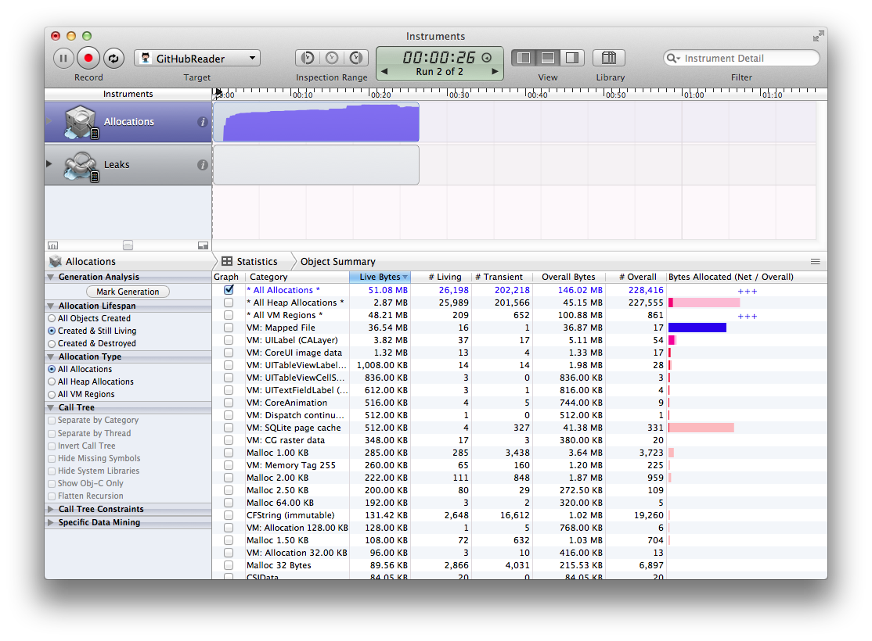
git checkout 03_async_gcd
Leaks Instruments to check progress
Much less memory pressure
Must faster view of first page of commits

Slide 37
git checkout 04_prefetch
Batch fetch for updates

Slide 38
BRCommitsViewController.m
NSFetchRequest *fetchRequest = [[NSFetchRequest alloc] init];
[fetchRequest setRelationshipKeyPathsForPrefetching:@[@"author"]];
[fetchRequest setFetchBatchSize:20];
04_prefetch

Slide 39
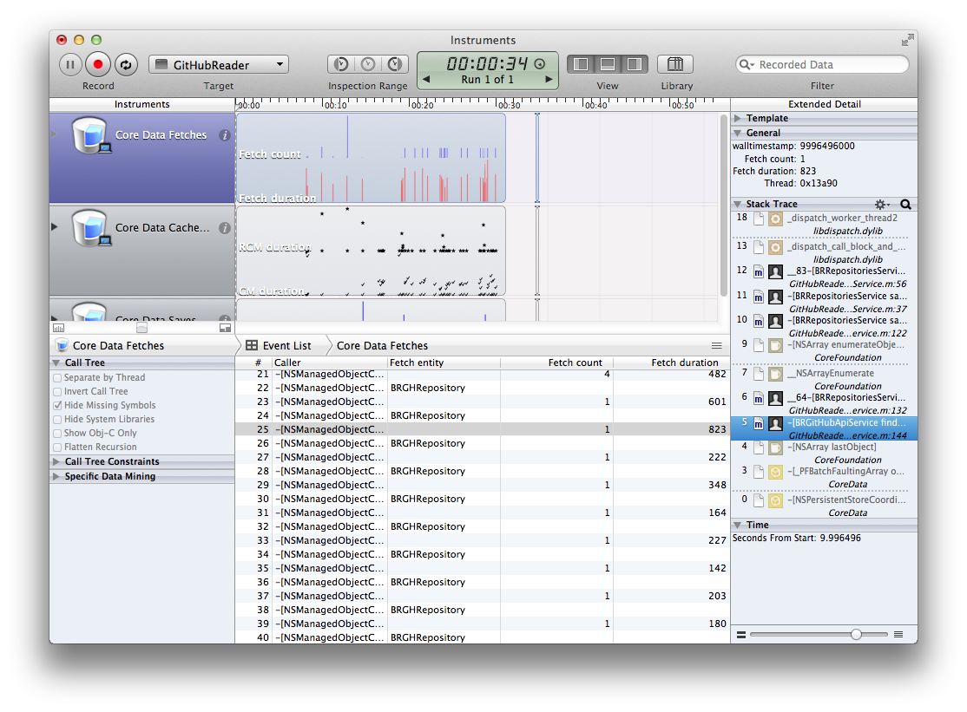
git checkout 04_prefetch
CoreData Instruments
Only works on Simulator
Lots of fetches
Lots of faults

Slide 40
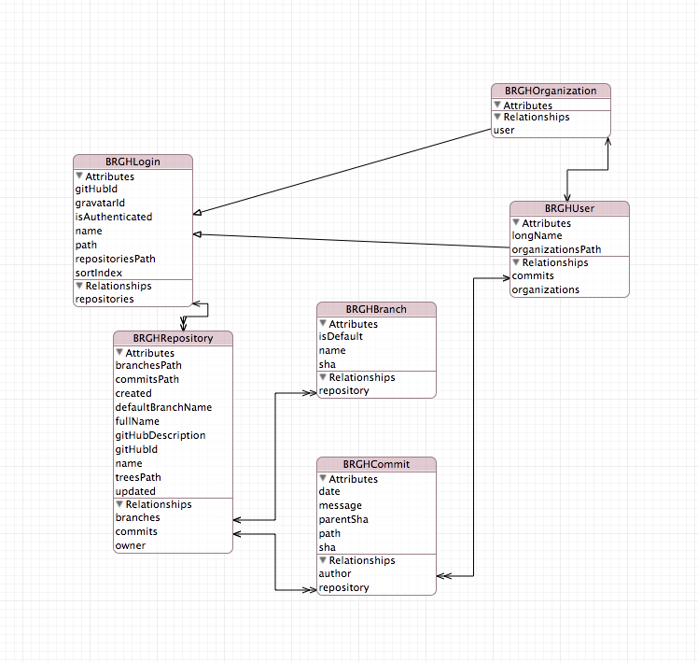
GitHubReader.xcadatamodel
03_async_gcd

Slide 41
Fetches
(fewer and
smaller line
is better)
Call stack
lines up with
scrubber
Timing
(smaller
is better)
Cache misses
(fewer is better)
Saves
(smaller
line is better)

Slide 42
BRCommitsService.m
- (BOOL)saveData:(NSArray *)json error:(NSError **)error {
// context set up
[json enumerateObjectsUsingBlock:^(id obj, NSUInteger idx, BOOL *stop) {
NSDictionary *itemJson = (NSDictionary *)obj;
BRGHCommit *commit = (BRGHCommit *)[apiService findOrCreateObjectById:sha];
[commit setMessage:[itemJson objectForKey:@"commit.message" orDefault:nil]];
// more reading json
}];
// relationships and cleanup
return [_context save:error];
}
04_prefetch

Slide 43
BRCommitsService.m
- (BOOL)saveData:(NSArray *)json error:(NSError **)error {
// context set up
// fetch all soon-to-be updated commits
NSArray *shas = [json valueForKeyPath:@"@distinctUnionOfObjects.sha"];
NSSortDescriptor *shaSort = [NSSortDescriptor sortDescriptorWithKey:key ascending:YES];
NSArray *oldCommitsArray = [apiService findObjectsByIds:shas];
[json enumerateObjectsUsingBlock:^(id obj, NSUInteger idx, BOOL *stop) {
NSDictionary *itemJson = (NSDictionary *)obj;
NSString *sha = (NSString *)[itemJson valueForKeyPath:@"sha"];
BRGHCommit *commit = oldCommits[sha];
if (!commit) {
commit = [NSEntityDescription insertNewObject...];
[commit setSha:sha];
}
// ... proceed forward as before
05_batch_fetch_update

Slide 44
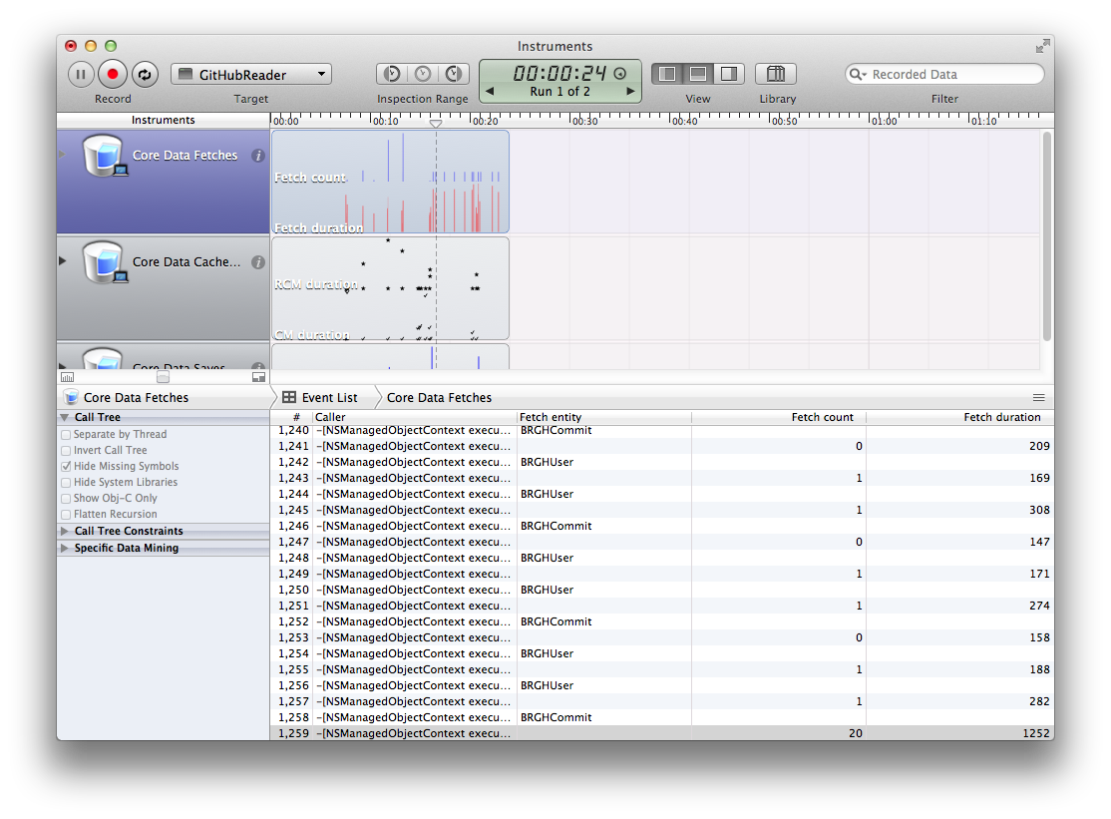
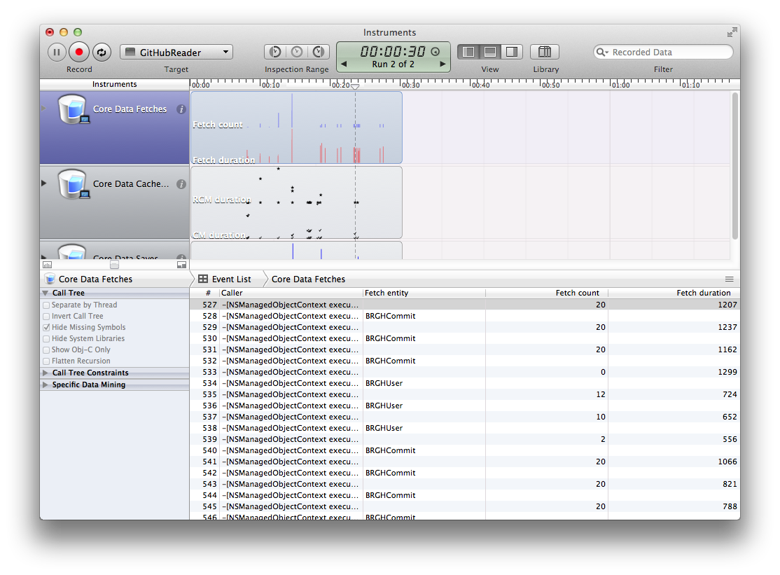
git checkout 05_batch_fetch_update
Core Data Instruments to check progress
One-off fetches for updates now batched

Slide 45
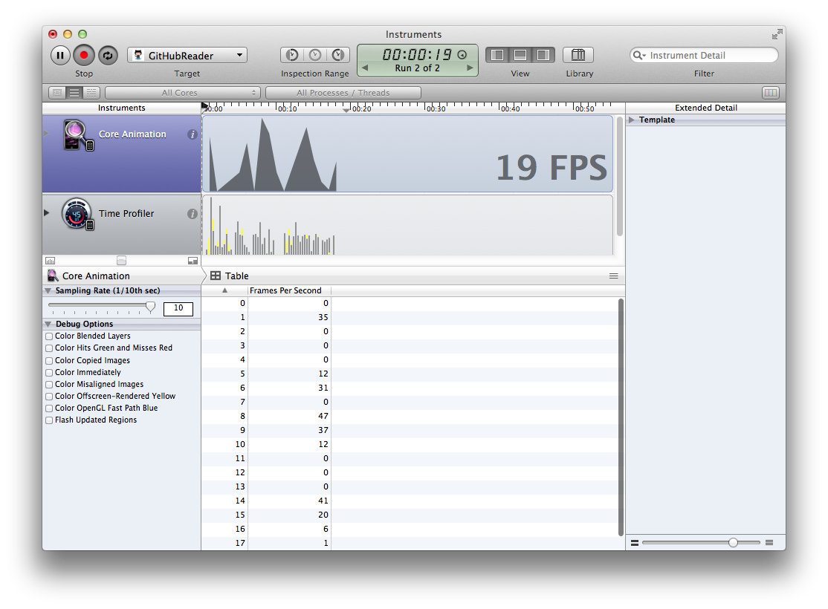
git checkout 02_memory_leak
Core Animation Instruments
Only works on Device
( reset app on device )
Slow table scrolling

Slide 46
Frames per second
(60 is best,
under 30 is bad)
Nothing
coordinates
in detail ☹
Time Profile is
included
History of FPS

Slide 47
git checkout 06_caching
HTTP LastModified
Local NSCache

Slide 48
BRCommitsViewController.m
- (void)configureCell:(UITableViewCell *)cell atIndexPath:(NSIndexPath *)indexPath {
BRGHCommit *commit = (BRGHCommit *)_commits[indexPath.row];
NSString *gravatarId = commit.author.gravatarId;
UIImage *image = [BRGravatarService imageForGravatarWithHash:gravatarId ofSize:80];
[cell.imageView setImage:image];
[cell.textLabel setText:commit.message];
}
02_memory_leak

Slide 49
BRGravatarService.m
+ (UIImage *)imageForGravatarWithHash:(NSString *)hash ofSize:(int)size {
[[UIApplication sharedApplication] setNetworkActivityIndicatorVisible:YES];
NSURL *url = [self urlForGravatarWithHash:hash ofSize:size];
UIImage *gravatarDownload = [UIImage imageWithData:[NSData dataWithContentsOfURL:url]];
UIImage *answer = [UIImage imageWithCGImage:[gravatarDownload CGImage]
scale:[[UIScreen mainScreen] scale]
orientation:UIImageOrientationUp];
[[UIApplication sharedApplication] setNetworkActivityIndicatorVisible:NO];
return answer;
}
02_memory_leak

Slide 50
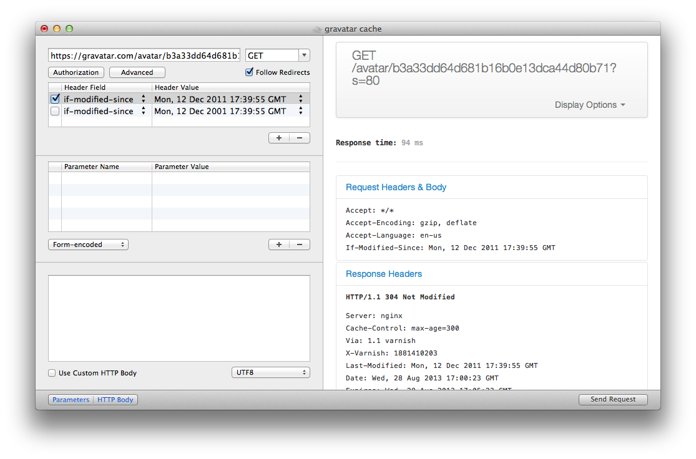

Slide 51
BRCommitsViewController.m
- (void)configureCell:(UITableViewCell *)cell atIndexPath:(NSIndexPath *)indexPath {
BRGHCommit *commit = (BRGHCommit *)_commits[indexPath.row];
UIImage *image = [_gravatarService cachedImageForLogin:commit.author];
UIImage *placeImage = image
? image
: [UIImage imageNamed:@"cell60"];
[cell.imageView setImage:placeImage];
}
06_caching

Slide 52
BRGravatarService.m
- (id)init {
self = [super init];
if (self) {
NSOperationQueue *queue = [[NSOperationQueue alloc] init];
[queue setName:@"BRGravatarService queue"];
[queue setMaxConcurrentOperationCount:3];
_queue = queue;
_thumbnailCache = [[NSCache alloc] init];
}
return self;
}
06_caching

Slide 53
BRGravatarService.m
- (void)saveGravatarsForLogin:(BRGHLogin *)login ofSize:(int)size {
NSMutableURLRequest *request = [[NSMutableURLRequest alloc] ...
[request setValue:lastModified forHTTPHeaderField:@"if-modified-since"];
[NSURLConnection sendAsynchronousRequest:request queue:_queue
completionHandler:^(NSURLResponse *response, NSData *data, NSError *connectionError) {[gravatar setImage:data];
[gravatar setLastModified:httpResponse.allHeaderFields[@"Last-Modified"]]; [context save:NULL];
}];
}
06_caching

Slide 54
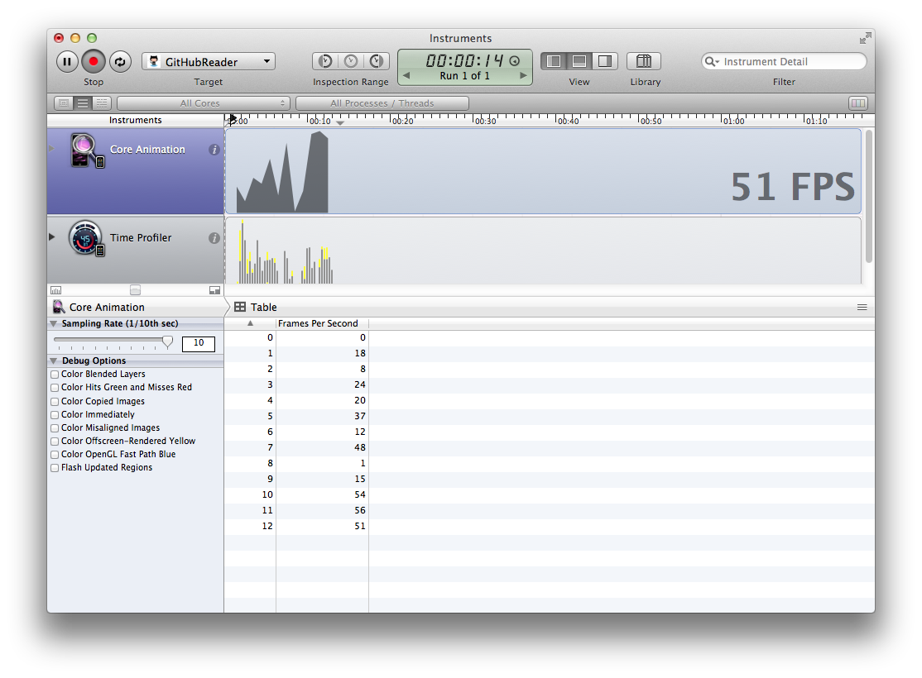
git checkout 06_caching
Core Animation Instruments to check progress
Fetching images off main UI thread
Using HTTP caching and local caching

Slide 55
git checkout 06_caching
This works for API calls too if the API vendor implements it

Slide 56
BRRepositoriesService.m
- (NSArray *)getRemoteData lastModified:(NSString **)lastModified withError:(NSError **)error {
BRGitHubApiService *api = [[BRGitHubApiService alloc] init];
NSURL *url = [NSURL URLWithString:gitHubLogin.repositoriesPath];
NSDictionary *headers = (gitHubLogin.repositoriesLastModified)
? @{@"if-modified-since": gitHubLogin.repositoriesLastModified}
: nil;
NSHTTPURLResponse *response = nil;
NSMutableURLRequest *request = [api requestFor ... withHeaders:headers];
NSData *data = [NSURLConnection sendSynchronous...Response:&response error:error];
if (response.statusCode == 304) {
return [NSArray array];
}
*lastModified = response.allHeaderFields[@"Last-Modified"];
return json;
}
06_caching

Slide 57
git checkout 06_caching
Watch service in debugger
Activity Instruments

Slide 58
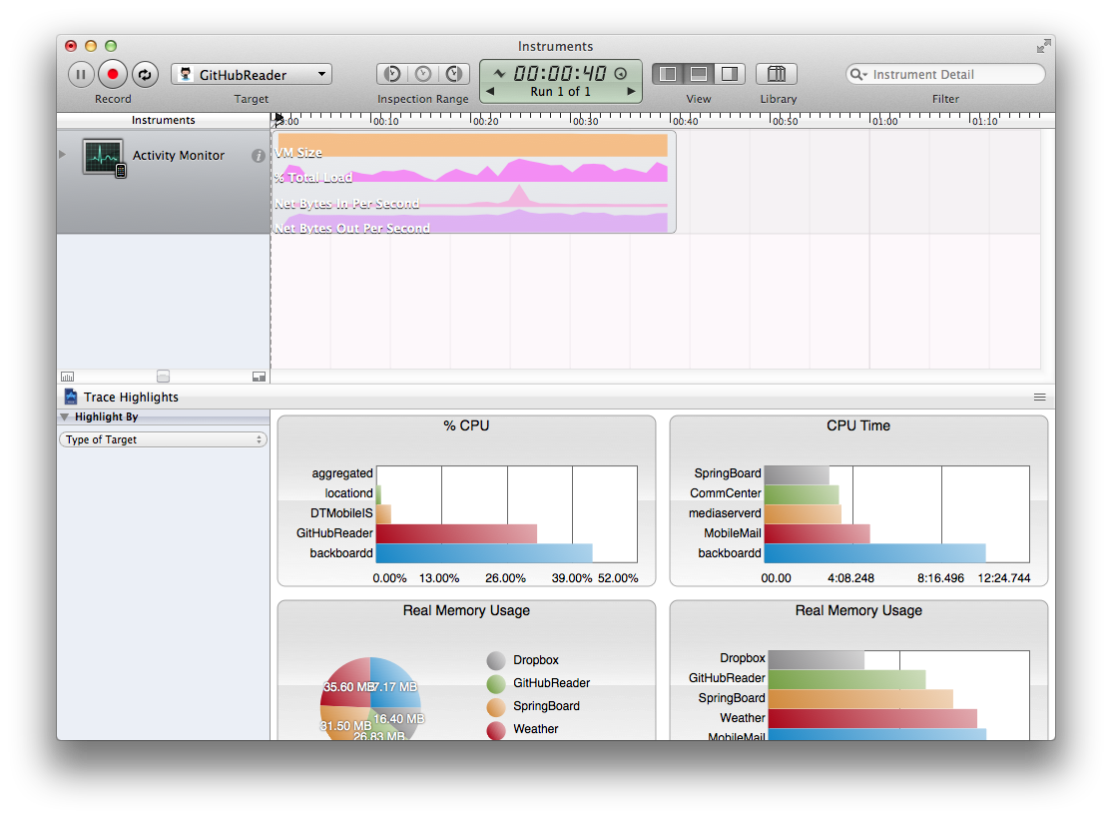
New json data
coming in
Cached data,
no network transfer

Slide 59
git checkout 07_spinners
Percieved Performance

Slide 60
BROrganizationsViewController.m
#import "UITableViewCell+activity.h”
- (void)tableView:(UITableView *)tableView didSelectRowAtIndexPath:(NSIndexPath *)indexPath {
BRGHLogin *login = (BRGHLogin *)[...
BRRepositoriesService *service = [...
UITableViewCell *cell = [self.tableView cellForRowAtIndexPath:indexPath];
[cell setActivityIndicatorAccessoryView];
[service begin... withCompletion:^(BOOL saved, NSError *error) {
[cell clearAccessoryViewWith:UITableViewCellAccessoryDisclosureIndicator];
[self performSegueWithIdentifier:@"SegueFromOrganizations" sender:indexPath];
}];
}
07_spinners

Slide 61
Review
Observe, Hypothesise, Experiment, Verify
Fork the repo and try this stuff on your own
Instruments
Leaks
Time Profiler
Core Data
Core Animations
Activity Monitor
Move heavy operations off the main UI thread

Slide 62
Additional Resources
WWDC 2013
Core Data Performance Optimization and Debugging
Designing Code for Performance
Apple Documentation
Threaded Core Data Example Source http://developer.apple.com/library/ios/samplecode/ThreadedCoreData/Introduction/Intro.html
Concurrency with Core Data http://developer.apple.com/library/ios/DOCUMENTATION/Cocoa/Conceptual/CoreData/Articles/cdConcurrency.html
Concurrency Programming Guide https://developer.apple.com/library/ios/documentation/General/Conceptual/ConcurrencyProgrammingGuide/Introduction/Introduction.html#//apple_ref/doc/uid/TP40008091
Other Interesting Frameworks
github API http://developer.github.com/guides/getting-started/
AFNetworking https://github.com/AFNetworking/AFNetworking
RestKit https://github.com/RestKit/RestKit/

Slide 63

Thanks guys! Enjoy the rest of devLink!
github.com/danielnorton @daniel_norton

